Slide 1
Electoral College Visualization / Analysis
Jonathan Gerraughty

Slide 2

Background and Overview
The US Election
Each state enlists electors to represent their districts voters.
Not all states have one elector (Some have as many as 50+)
First nominee to 270 Electoral Votes wins
Simple?

Slide 3
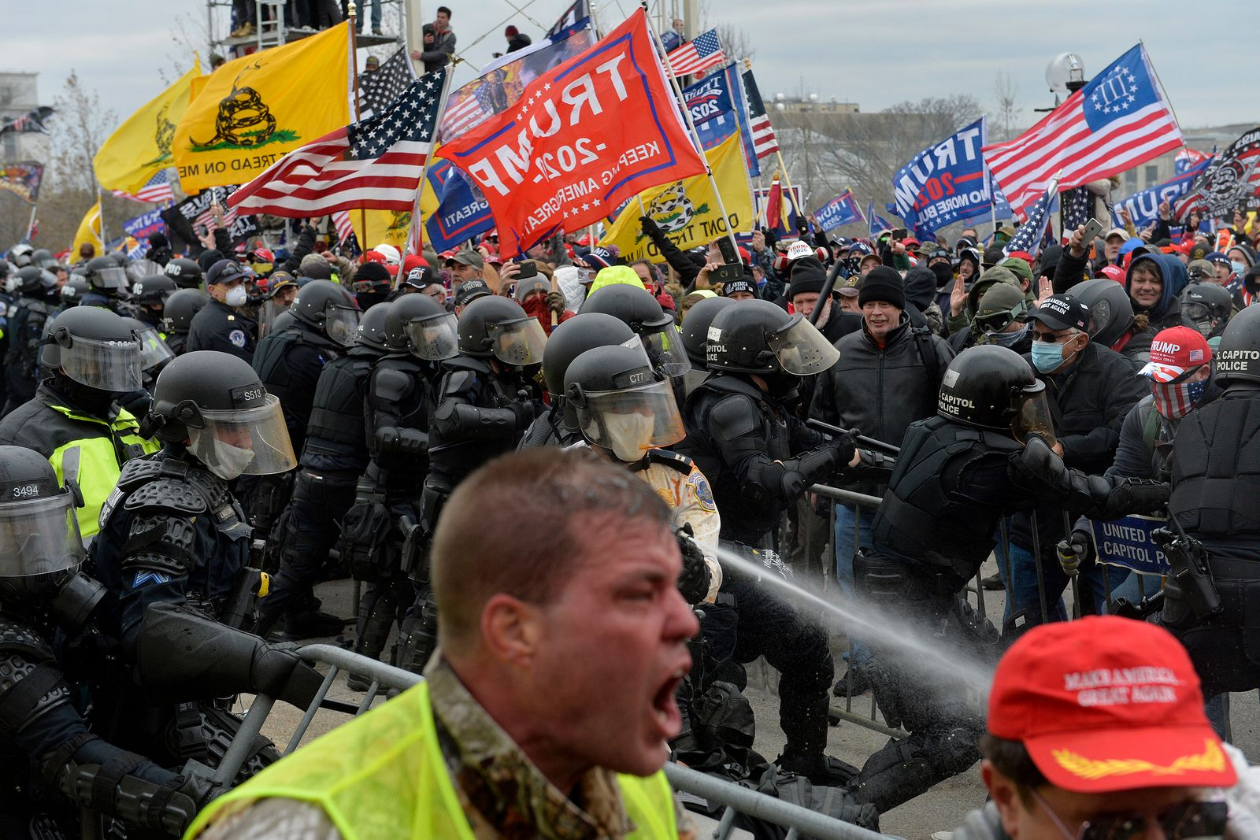
Inspiration
2020 US Election
“Stolen ballots, fraudulent voting machines.”
All of this led to a riot…literally!

Slide 4
Project Goal
To display electoral college data in a way that is visually appealing while remaining accurate.
To find any correlation or significant finding on the claims of a stolen election

Slide 5
Sources
Electoral college Results: https://www.archives.gov/electoral-college/results
GeoJSON File: https://github.com/scotthmurray/d3-book

Slide 6
Demo

